Slide 1
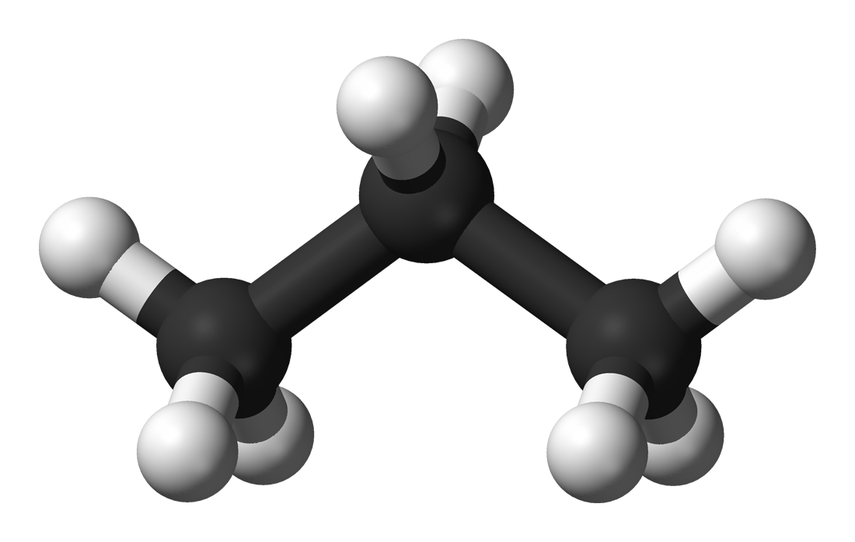


Propane: Programming
Distributed Control Planes
Ryan Beckett (Princeton, MSR)
Ratul Mahajan (MSR)
Todd Millstein (UCLA)
Jitu Padhye (MSR)
David Walker (Princeton)

Slide 2
Configuring Networks is Error-Prone
~60% of network downtime is caused by human error
-Yankee group 2002
50-80% of outages are the result of human error
-Juniper 2008

Slide 3
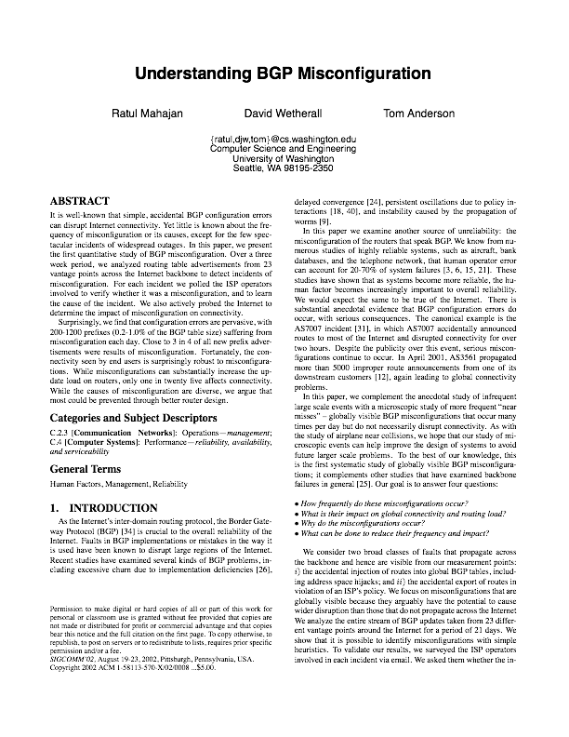
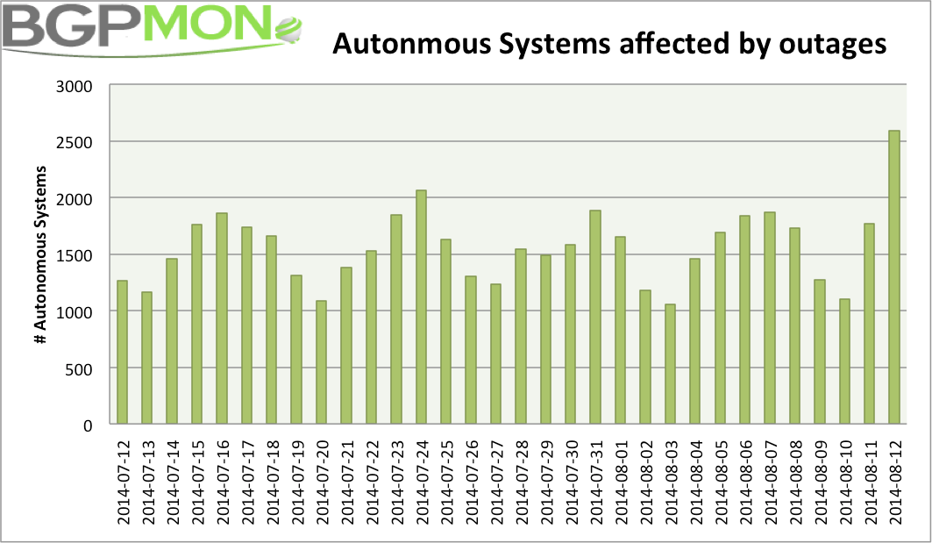
Configuring Networks is Error-Prone
“Close to 3 in 4 of all new prefix advertisements were results of misconfiguration”
~1500 ASes affected by outages every day

Slide 4


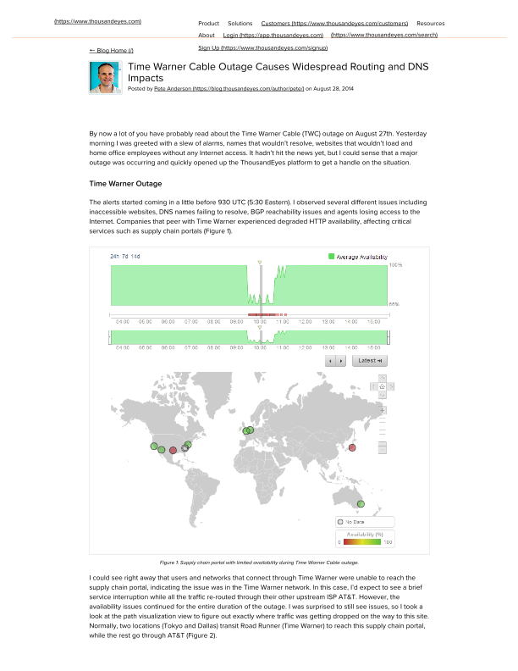

Configuring Networks is Error-Prone

Slide 5
Objectives Mechanisms
GAP
Objectives: Network-wide
Prefer traffic go through AT&T over Sprint
Don’t use our network as transit between A and B
Traffic must stay within national boundaries
Adhere to policies even when failures occur

Slide 6
Objectives Mechanisms
GAP
Objectives: Network-wide
Prefer traffic go through AT&T over Sprint
Don’t use our network as transit between A and B
Traffic must stay within national boundaries
Adhere to policies even when failures occur

Slide 7
Objectives Mechanisms
GAP
Objectives: Network-wide
Prefer traffic go through AT&T over Sprint
Don’t use our network as transit between A and B
Traffic must stay within national boundaries
Adhere to policies even when failures occur
Mechanisms: Device-by-Device
Local decisions made independently on each device
Several device-level actions together imply some higher-level behavior
Failures interact with local decision-making algorithms in complex ways
“a large backbone network may have a thousand different policies
configured across hundreds of routers” [Feamster 2005]

Slide 8
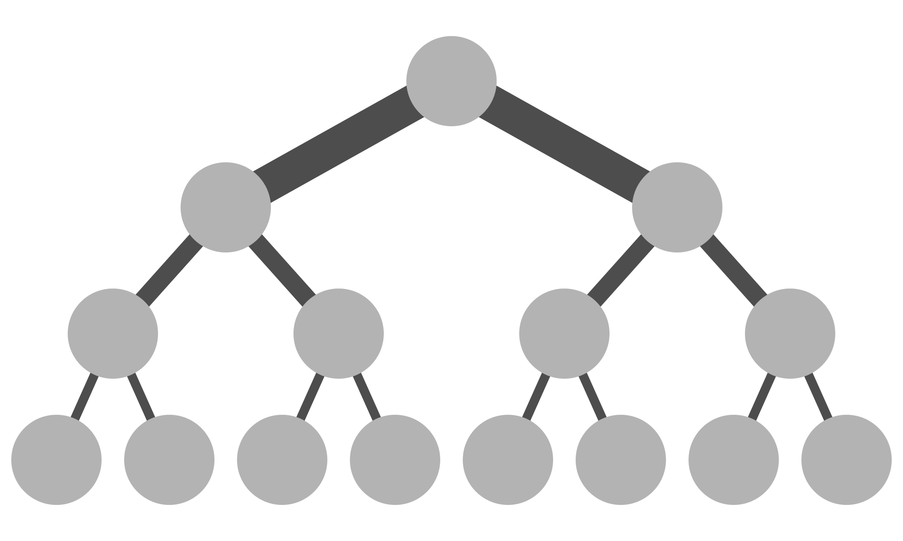

Why use BGP?
BGP in the Wild
Inter-domain routing between Autonomous Systems (AT&T, Sprint)
Intra-domain routing in data centers
Advantages
Allows for local policy among nodes
Massively scalable — hundreds of thousands of IP prefixes
Fully distributed — does not require global knowledge of network state
Sprint
AT&T
Notes:
If so hard to configure, why is BGP used, and how is it used?

Slide 9
What about SDN?
Software Defined Networks
Simpler, centralized programming models
Network-wide abstractions like paths
Centralized controller programs the network
But they are not a panacea:
Do not usually help with inter-domain routing
Latency, and scalability can be problematic for large networks
Require careful design and engineering to be robust to failures
Their implementations don’t exploit existing network infrastructure

Slide 10
Propane: Programming a
Distributed Control Plane
I) Language for expressing high-level operator objectives with:
Network-wide programming abstraction
Uniform abstractions for intra- and inter-domain routing
Paths constraints and relative preferences with fall-backs in case of failures
AS 2
AS 1
AS 3

Slide 11

Propane: Programming a
Distributed Control Plane
2) Compiler to generate a low-level distributed implementation:
Efficient algorithms to synthesize a set of policy-compliant BGP configs
Static analysis guarantees policy compliance under all failures
Backup
Network partition — drop
￼

Slide 12
Border Gateway Protocol (BGP)
Routers send advertisements for a destination (e.g., 16.4.0.0/16)
Advertisements contain the AS path traffic would take
Each router applies local policy to choose best route
Import filters drop advertisements or modify attributes
Highest preference is chosen. Path length as a tie breaker
Export filters drop advertisements or modify attributes
local-pref←100
X
tag(“foo”)
local-pref←99

Slide 13
Border Gateway Protocol (BGP)
1. Prefer C over A
1. Block “red” routes
B
D
A
16.4.0.0/16
C
E
1. Prefer B over A
2. Tag routes “red”
3. Don’t export to E

Slide 14
Border Gateway Protocol (BGP)
1. Prefer C over A
1. Block “red” routes
B
D
path = A
A
16.4.0.0/16
C
E
path = A
1. Prefer B over A
2. Tag routes “red”
3. Don’t export to E
advertisement
pkt forwarding

Slide 15
Border Gateway Protocol (BGP)
1. Prefer C over A
1. Block “red” routes
B
D
A
16.4.0.0/16
C
E
1. Prefer B over A
2. Tag routes “red”
3. Don’t export to E
advertisement
pkt forwarding

Slide 16
Border Gateway Protocol (BGP)
1. Prefer C over A
1. Block “red” routes
B
D
X
A
16.4.0.0/16
path = CA
C
E
X
1. Prefer B over A
2. Tag routes “red”
3. Don’t export to E
advertisement
pkt forwarding

Slide 17
Border Gateway Protocol (BGP)
1. Prefer C over A
1. Block “red” routes
B
D
A
16.4.0.0/16
C
E
1. Prefer B over A
2. Tag routes “red”
3. Don’t export to E
advertisement
pkt forwarding

Slide 18
Border Gateway Protocol (BGP)
1. Prefer C over A
1. Block “red” routes
B
D
X
A
16.4.0.0/16
path = BCA
C
E
1. Prefer B over A
2. Tag routes “red”
3. Don’t export to E
advertisement
pkt forwarding

Slide 19
Border Gateway Protocol (BGP)
1. Prefer C over A
1. Block “red” routes
B
D
A
16.4.0.0/16
C
E
1. Prefer B over A
2. Tag routes “red”
3. Don’t export to E
advertisement
pkt forwarding

Slide 20
Border Gateway Protocol (BGP)
1. Prefer C over A
1. Block “red” routes
B
D
A
16.4.0.0/16
path = BA
C
E
1. Prefer B over A
2. Tag routes “red”
3. Don’t export to E
advertisement
pkt forwarding

Slide 21
Border Gateway Protocol (BGP)
1. Prefer C over A
1. Block “red” routes
B
D
A
16.4.0.0/16
C
E
1. Prefer B over A
2. Tag routes “red”
3. Don’t export to E
advertisement
pkt forwarding

Slide 22
Border Gateway Protocol (BGP)
Aggregation (Route summarization)
Advertise a more general subnetwork
Information hiding for routers
Reduces router table size and improves stability
C
16.4.2.0/24
B
D
16.4.0.0/16
E
16.4.1.0/24
A
16.4.0.0/24

Slide 23
Example 1: Backbone Network
Sprint
Level3
R1
R2
Cust
Princeton
16.4.0.0/16

Slide 24
Example 1: Backbone Network
block(“Peer”)
block(“Peer”)
tag(“Peer”)
tag(“Peer”)
Sprint
Level3
R1
R2
Cust
Princeton
16.4.0.0/16
Goals
Prevent transit between peers ($$$)
16.4.0.0/16

Slide 25
Example 1: Backbone Network
block(“Peer”)
block(“Peer”)
tag(“Peer”)
tag(“Peer”)
Sprint
Level3
R1
R2
lp←99
lp←100
lp←101
Cust
Princeton
16.4.0.0/16
Goals
Prevent transit between peers ($$$)
Prefer R2 > R1 > Peer ($$$)
16.4.0.0/16

Slide 26
Example 1: Backbone Network
filter(16.4.0.0/16, _Princeton)
block(“Peer”)
block(“Peer”)
tag(“Peer”)
tag(“Peer”)
Sprint
Level3
R1
R2
lp←99
lp←100
lp←101
filter(16.4.0.0/16, _Princeton)
Cust
Princeton
16.4.0.0/16
Goals
Prevent transit between peers ($$$)
Prefer R2 > R1 > Peer ($$$)
Filter customer by prefix (security)
16.4.0.0/16

Slide 27
Example 1: Backbone Network
Sprint
Level3
R1
R2
Cust
Prevent transit between peers
Princeton
16.4.0.0/16
define Peer = {Sprint, Level3}
define transit(X,Y) = enter(X) and exit(Y)
define NoTransit = {
true => !transit(Peer,Peer)
}

Slide 28
Example 1: Backbone Network
Sprint
Level3
R1
R2
Cust
Prefer R2 > R1 > Peer
Princeton
16.4.0.0/16
…
define Preferences = {
true => exit(R2 >> R1 >> Peer)
}

Slide 29
Example 1: Backbone Network
Sprint
Level3
R1
R2
Cust
Filter customer by prefix
Princeton
16.4.0.0/16
…
define Ownership = {
16.4.0.0/16 => end(Princeton),
}
define Main =
Preferences & Ownership & NoTransit

Slide 30
Example 2: A Data Center Network
Peer1
Peer2
Goals
Local prefixes reachable only internally
Global prefixes reachable externally
Aggregate global prefixes as PG
Prefer leaving through Peer1 over Peer2
Prevent transit traffic between peers
X
Y
Y
C
D
C
D
G
H
G
H
A
A
B
B
E
F
E
F
PG1
PG2
PL1
PL2
Global
Services
Local
Services

Slide 31
Example 2: A Data Center Network
Peer1
Peer2
Goals
Local prefixes reachable only internally
Global prefixes reachable externally
Aggregate global prefixes as PG
Prefer leaving through Peer1 over Peer2
Prevent transit traffic between peers
PG
X
Y
Y
C
D
C
D
G
H
G
H
Attempt (1)
X and Y allow adv. from C,D to peers
X and Y do not allow adv. from G,H to peers
Aggregate to PG externally
A
A
B
B
E
F
E
F
PG1
PG2
PL1
PL2
Global
Services
Local
Services

Slide 32
Example 2: A Data Center Network
Peer1
Peer2
Goals
Local prefixes reachable only internally
Global prefixes reachable externally
Aggregate global prefixes as PG
Prefer leaving through Peer1 over Peer2
Prevent transit traffic between peers
PG
X
Y
Y
C
D
C
D
G
H
G
H
Attempt (1)
X and Y allow adv. from C,D to peers
X and Y do not allow adv. from G,H to peers
Aggregate to PG externally
A
A
B
B
E
F
E
F
PG1
PG2
PL1
PL2
Global
Services
Local
Services

Slide 33
Example 2: A Data Center Network
Peer1
Peer2
Goals
Local prefixes reachable only internally
Global prefixes reachable externally
Aggregate global prefixes as PG
Prefer leaving through Peer1 over Peer2
Prevent transit traffic between peers
X
Y
Y
C
D
C
D
G
H
G
H
Attempt (1)
X and Y allow adv. from C,D to peers
X and Y do not allow adv. from G,H to peers
X and Y drop routes through each other
Aggregate to PG externally
A
A
B
B
E
F
E
F
PG1
PG2
PL1
PL2
Global
Services
Local
Services

Slide 34
Example 2: A Data Center Network
Peer1
Peer2
Goals
Local prefixes reachable only internally
Global prefixes reachable externally
Aggregate global prefixes as PG
Prefer leaving through Peer1 over Peer2
Prevent transit traffic between peers
PG
PG
X
Y
Y
C
D
C
D
G
H
G
H
Attempt (1)
X and Y allow adv. from C,D to peers
X and Y do not allow adv. from G,H to peers
X and Y drop routes through each other
Aggregate to PG externally
A
A
B
B
E
F
E
F
PG1
PG2
PL1
PL2
Global
Services
Local
Services

Slide 35
Example 2: A Data Center Network
Peer1
Peer2
Goals
Local prefixes reachable only internally
Global prefixes reachable externally
Aggregate global prefixes as PG
Prefer leaving through Peer1 over Peer2
Prevent transit traffic between peers
Traffic
for PG1
dropped
X
Y
Y
C
D
C
D
G
H
G
H
Attempt (1)
X and Y allow adv. from C,D to peers
X and Y do not allow adv. from G,H to peers
X and Y drop routes through each other
Aggregate to PG externally
A
A
B
B
E
F
E
F
PG1
PG2
PL1
PL2
Global
Services
Local
Services
Aggregation Black hole!

Slide 36

Example 2: A Data Center Network
Peer1
Peer2
Basic reachability for prefixes
define PL1 = 1.0.0.0/24
…
define Ownership = {
PG1 => end(A),
PG2 => end(B),
PL1 => end(E),
PL2 => end(F),
true => exit(Peer1) >> exit(Peer2)
}
X
Y
Y
C
D
C
D
G
H
G
H
A
A
B
B
E
F
E
F
PG1
PG2
PL1
PL2
Global
Services
Local
Services

Slide 37
Example 2: A Data Center Network
Peer1
Peer2
Local services stay internal
…
define Locality = {
PL1 or PL2 => always(in)
}
X
Y
Y
C
D
C
D
G
H
G
H
A
A
B
B
E
F
E
F
PG1
PG2
PL1
PL2
Global
Services
Local
Services

Slide 38
Example 2: A Data Center Network
Peer1
Peer2
Prevent transit traffic
…
define Locality = {
PL1 or PL2 => always(in)
}
define NoTransit = {
true => ! transit(Peer,Peer)
}
X
Y
Y
C
D
C
D
G
H
G
H
A
A
B
B
E
F
E
F
PG1
PG2
PL1
PL2
Global
Services
Local
Services

Slide 39
Example 2: A Data Center Network
Peer1
Peer2
Prevent transit traffic
…
define Main =
Ownership & Locality & NoTransit
& agg(PG, in → out)
X
Y
Y
C
D
C
D
G
H
G
H
A
A
B
B
E
F
E
F
PG1
PG2
PL1
PL2
Global
Services
Local
Services

Slide 40
Propane Compiler

Slide 41
Propane Compiler

Slide 42
Propane Compiler

Slide 43
Propane Compiler

Slide 44
Propane: Summary
High-level language
Single, network-wide policy
Program using constraints and preferences
Create new, reusable abstractions (e.g., transit traffic)
Configure the network modularly
Compiler
Automatically generates filters, preferences, community values, etc
Static analysis guarantees policy compliance under all failures
Lower bound on failures for aggregation-induced black holes

Slide 45


Compilation
Propane
Front End Constraint Language
Regular
IR
Regular Expression-based IR
Topology
Product
Graph IR
Failure
Analyses
Abstract
BGP
Vendor-independent BGP
…
Quagga
Vendor-specific configurations

Slide 46

Propane Regular IR (RIR) Syntax
p ::= c1, …, cn
c ::= t1 ↦ r1 >> … >> rn
t ::= true
| (t1 | t2)
| t1 & t2
| prefix=x
r ::= n
| ∅
| in
| out
| (r1 | r2)
| r1 & r2
| r1 · r2
| !r
| r*
Path Preferences
Traffic predicates
Regular expression
path constraints

Slide 47
Propane Examples:
Go through either X or Y, but prefer to go through X if possible to get to D
in*.(X >> Y).D
Use path ABC if possible (e.g., failures), otherwise use XYZ
A.B.C >> X.Y.Z
Use locations A,B,C,D but always prefer A,B to C,D at each hop if possible
((A|B) >> (C|D))*
Disallow any transit traffic (i.e., traffic that goes through our network)
!(out+.in*.out+)

Slide 48

Propane Regular IR
Propane
Step 1: Combine modular constraints
Regular
IR
define Ownership =
{PG1 => end(A)
PG2 => end(B)
PL1 => end(E)
PL2 => end(F)
true => exit(Peer1 >> Peer2)}
define NoTransit =
{true => !transit(Peer,Peer)}
define Locality =
{PL1 | PL2 => always(in)}
define Main =
Ownership & Locality & NoTransit
& agg(PG, in -> out)

Slide 49

Propane Regular IR
Propane
Regular
IR
Prefix-by-prefix intersection of constraints
PG1 => !transit(Peer,Peer) & end(A)
PG2 => !transit(Peer,Peer) & end(B)
PL1 => !transit(Peer,Peer) & always(in) & end(E)
PL2 => !transit(Peer,Peer) & always(in) & end(F)
true => !transit(Peer,Peer) & exit(Peer1 >> Peer2)

Slide 50
Propane Regular IR
Propane
Step 2: Expand constraints in to regular expressions
Regular
IR
any = out*.in+.out*
end(X) = (Σ*.X)
always(X) =
(X)*
exit(X) =
(out*.in*.(X ∩ in).out+)|
(out*.in+.(X ∩ out).out*)
(X.Σ*)
start(X) =
avoid(X) =
(!X)*
(Σ*.X.Σ*)
waypoint(X) =
Step 3: Reduced syntax
true => A.(X >> Y).out*
true => (A.X.out*) >> (A.Y.out*)

Slide 51
Propane Regular IR
Problem Formulation
Policy of the form:
Semantics — sets of ranked topology paths (preference, length)
t ↦ r1 >> … >> rn
rank(p) = (mini p∈ℒ(ri), |p|)
Determine device-by-device filters, tags, local-preferences so a most preferred path is always obtained.
AS 2
AS 1
AS 3

Slide 52
Compilation: The Issue
A
D
Policy:
(X.A.C.D.Y) >>
(X.B.C.E.Y)
Y
C
X
E
B
Attempt 1:
C - Prefer D over E
X - Prefer A over B

Slide 53
Compilation: The Issue
A
D
Policy:
(X.A.C.D.Y) >>
(X.B.C.E.Y)
Y
C
X
E
B
Attempt 1:
C - Prefer D over E
X - Prefer A over B
Issue:
Violation of soundness — take a path not specified by the policy

Slide 54
Compilation: The Issue
A
D
Policy:
(X.A.C.D.Y) >>
(X.B.C.E.Y)
Y
C
X
E
B
Attempt 1:
C - Prefer D over E
X - Prefer A over B
Issue:
Violation of soundness — take a path not specified by the policy
Soundness is easy to handle by filtering bad paths (filter at B)

Slide 55
Compilation: The Issue
A
D
Policy:
(X.A.C.D.Y) >>
(X.B.C.E.Y)
Y
C
X
E
B
Attempt 1:
C - Prefer D over E
X - Prefer A over B
B - Filter routes through D
Issue:
Violation of completeness — path with preference 2 exists, yet none is taken

Slide 56
Compilation: An Idealized Example
X
Y
W
A
D
B
C
E
Z
Policy:
(W.A.C.D.out) >> (W.B.in+.out)

Slide 57
Compilation: An Idealized Example
X
Y
W
A
D
B
C
E
Z
Policy:
(W.A.C.D.out) >> (W.B.in+.out)

Slide 58
Compilation: An Idealized Example
X
Y
W
A
D
B
C
E
Z
Policy:
(W.A.C.D.out) >> (W.B.in+.out)

Slide 59
Reversed Automata from Policies
X
Y
W
A
D
B
C
E
Z
Reversed automata
tracks BGP message flow
Policy:
out
D
C
A
W
0
1
2
3
4
5
1. (W.A.C.D.out)
2. (W.B.in+.out)
ACDE
B
out
in
B
W
0
1
2
3
4
ACDE

Slide 60
Constructing the Product Graph (PG)
start
(W.A.C.D.out) >> (W.B.in+.out)
X
Y
W
A
D
B
C
E
Z
out
D
C
A
W
0
1
2
3
4
5
ACDE
B
out
in
B
W
0
1
2
3
4
ACDE

Slide 61
Constructing the Product Graph (PG)
start
(W.A.C.D.out) >> (W.B.in+.out)
(X,1,1)
X
Y
W
A
D
B
C
E
Z
out
D
C
A
W
0
1
2
3
4
5
ACDE
B
out
in
B
W
0
1
2
3
4
ACDE

Slide 62
Constructing the Product Graph (PG)
start
(W.A.C.D.out) >> (W.B.in+.out)
(X,1,1)
X
Y
W
A
(D,2,2)
D
B
C
E
Z
out
D
C
A
W
0
1
2
3
4
5
ACDE
B
out
in
B
W
0
1
2
3
4
ACDE

Slide 63
Constructing the Product Graph (PG)
start
(W.A.C.D.out) >> (W.B.in+.out)
(X,1,1)
X
Y
W
A
(D,2,2)
D
B
C
E
(C,3,2)
Z
out
D
C
A
W
0
1
2
3
4
5
ACDE
B
out
in
B
W
0
1
2
3
4
ACDE

Slide 64
Constructing the Product Graph (PG)
start
(W.A.C.D.out) >> (W.B.in+.out)
(X,1,1)
X
Y
W
A
(D,2,2)
D
B
C
E
(C,3,2)
Z
(A,4,2)
out
D
C
A
W
0
1
2
3
4
5
ACDE
B
out
in
B
W
0
1
2
3
4
ACDE

Slide 65
Constructing the Product Graph (PG)
start
(W.A.C.D.out) >> (W.B.in+.out)
(X,1,1)
X
Y
W
A
(D,2,2)
D
B
C
E
(C,3,2)
Z
(A,4,2)
out
D
C
A
W
0
1
2
3
4
5
(W,5, -)
ACDE
B
{1}
out
in
B
W
0
1
2
3
4
ACDE

Slide 66
Constructing the Product Graph (PG)
start
(W.A.C.D.out) >> (W.B.in+.out)
(Y,1,1)
(X,1,1)
X
Y
W
A
(D,2,2)
D
B
C
E
(C,3,2)
Z
(A,4,2)
out
D
C
A
W
0
1
2
3
4
5
(W,5, -)
ACDE
B
{1}
out
in
B
W
0
1
2
3
4
ACDE

Slide 67
Constructing the Product Graph (PG)
start
(W.A.C.D.out) >> (W.B.in+.out)
(W,1,1)
(Z,1,1)
(Y,1,1)
(X,1,1)
X
Y
W
A
(A, -,2)
(B, -,2)
(E, -,2)
(D,2,2)
D
B
C
E
(C, -,2)
(D, -,2)
(C,3,2)
Z
(B, -,3)
(A,4,2)
out
D
C
A
W
0
1
2
3
4
5
(W, -, 4)
(W,5, -)
ACDE
B
{2}
{1}
out
in
B
W
end
0
1
2
3
4
ACDE

Slide 68
Constructing the Product Graph (PG)
start
(W.A.C.D.out) >> (W.B.in+.out)
(W,1,1)
(Z,1,1)
(Y,1,1)
(X,1,1)
X
Y
W
A
(A, -,2)
(B, -,2)
(E, -,2)
(D,2,2)
D
B
C
E
(C, -,2)
(D, -,2)
(C,3,2)
Z
(B, -,3)
(A,4,2)
out
D
C
A
W
0
1
2
3
4
5
(W, -, 4)
(W,5, -)
ACDE
B
{2}
{1}
out
in
B
W
end
0
1
2
3
4
ACDE
Notes:
One of the useful properties about the Product Graph…

Slide 69
Constructing the Product Graph (PG)
start
(W.A.C.D.out) >> (W.B.in+.out)
(W,1,1)
(Z,1,1)
(Y,1,1)
(X,1,1)
X
Y
W
A
(A, -,2)
(B, -,2)
(E, -,2)
(D,2,2)
D
B
C
E
(C, -,2)
(D, -,2)
(C,3,2)
Z
(B, -,3)
(A,4,2)
out
D
C
A
W
0
1
2
3
4
5
(W, -, 4)
(W,5, -)
ACDE
B
{2}
{1}
out
in
B
W
end
0
1
2
3
4
ACDE

Slide 70
Constructing the Product Graph (PG)
start
(W,1,1)
(Z,1,1)
(Y,1,1)
(X,1,1)
X
Y
W
A
(A, -,2)
(B, -,2)
(E, -,2)
(D,2,2)
D
B
C
E
(C, -,2)
(D, -,2)
(C,3,2)
Z
(B, -,3)
(A,4,2)
(W, -, 4)
(W,5, -)
Compact representation of all paths through
the topology subject to policy constraints
{2}
{1}
end

Slide 71
Constructing the Product Graph (PG)
start
(W,1,1)
(Z,1,1)
(Y,1,1)
(X,1,1)
X
Y
W
A
(A, -,2)
(B, -,2)
(E, -,2)
(D,2,2)
D
B
C
E
(C, -,2)
(D, -,2)
(C,3,2)
Z
(B, -,3)
(A,4,2)
out
D
C
A
W
0
1
2
3
4
5
(W, -, 4)
(W,5, -)
ACDE
B
{2}
{1}
out
in
B
W
end
0
1
2
3
4

Slide 72
PG Minimization (Loop analysis)
start
start
(W,1,1)
(Z,1,1)
(Y,1,1)
(X,1,1)
(Z,1,1)
(Y,1,1)
(X,1,1)
(A, -,2)
(B, -,2)
(E, -,2)
(D,2,2)
(E, -,2)
(D,2,2)
(C, -,2)
(D, -,2)
(C,3,2)
(C, -,2)
(C,3,2)
(B, -,3)
(A,4,2)
(B, -,3)
(A,4,2)
Must end at W
(W, -, 4)
(W,5, -)
{2}
(W, -, 4)
(W,5, -)
{1}
{2}
end
{1}
end

Slide 73
Compilation to BGP:
start
(Z,1,1)
(Y,1,1)
(X,1,1)
Idea 1: Restrict advertisements to PG edges
Encode PG state in community tag
Incoming edges — import filters
Outgoing edges — export filters
(E, -,2)
(D,2,2)
(C, -,2)
(C,3,2)
(B, -,3)
(A,4,2)
Let BGP find some allowed path dynamically
{2}
(W, -, 4)
(W,5, -)
{1}
end

Slide 74
Compilation to BGP:
start
(Z,1,1)
(Y,1,1)
(X,1,1)
(E, -,2)
(D,2,2)
C allows import from D with tag (2,2)
(C, -,2)
(C,3,2)
(B, -,3)
(A,4,2)
{2}
(W, -, 4)
(W,5, -)
{1}
end

Slide 75
Compilation to BGP:
start
(Z,1,1)
(Y,1,1)
(X,1,1)
(E, -,2)
(D,2,2)
(C, -,2)
(C,3,2)
C exports to A,B with tag (3,2)
(B, -,3)
(A,4,2)
{2}
(W, -, 4)
(W,5, -)
{1}
end

Slide 76
Compilation to BGP:
start
(Z,1,1)
(Y,1,1)
(X,1,1)
X
Y
W
(E, -,2)
(D,2,2)
(2,2)
A
(C, -,2)
(C,3,2)
D
B
C
E
(B, -,3)
(A,4,2)
(-,2)
Z
{2}
(W, -, 4)
(W,5, -)
{1}
end
Policy:
(W.A.C.D.out) >> (W.B.in+.out)

Slide 77
Compilation to BGP:
start
(Z,1,1)
(Y,1,1)
(X,1,1)
X
Y
W
(E, -,2)
(D,2,2)
A
(C, -,2)
(C,3,2)
(3,2)
D
B
C
E
(-,2)
(B, -,3)
(A,4,2)
Z
{2}
(W, -, 4)
(W,5, -)
{1}
end
Policy:
(W.A.C.D.out) >> (W.B.in+.out)

Slide 78
Compilation to BGP:
start
(Z,1,1)
(Y,1,1)
(X,1,1)
X
Y
W
(E, -,2)
(D,2,2)
A
(C, -,2)
(C,3,2)
D
B
C
E
(-,3)
(B, -,3)
(A,4,2)
Z
{2}
(W, -, 4)
(W,5, -)
{1}
end
Policy:
(W.A.C.D.out) >> (W.B.in+.out)

Slide 79
Compilation to BGP:
start
(Z,1,1)
(Y,1,1)
(X,1,1)
X
Y
W
(E, -,2)
(D,2,2)
A
(-,4)
(C, -,2)
(C,3,2)
D
B
C
E
(B, -,3)
(A,4,2)
Z
{2}
(W, -, 4)
(W,5, -)
{1}
end
Policy:
(W.A.C.D.out) >> (W.B.in+.out)

Slide 80
Compilation to BGP:
start
(Z,1,1)
(Y,1,1)
(X,1,1)
X
Y
W
(E, -,2)
(D,2,2)
A
Not ideal!
(C, -,2)
(C,3,2)
D
B
C
E
(B, -,3)
(A,4,2)
Z
{2}
(W, -, 4)
(W,5, -)
{1}
A better path exists in the
network, but is not used!
end

Slide 81
Compilation to BGP:
start
(Z,1,1)
(Y,1,1)
(X,1,1)
Idea 2: Find local preferences
Direct BGP towards best path
Under all combinations of failures
Frame in terms of graph algorithms
(E, -,2)
(D,2,2)
(C, -,2)
(C,3,2)
(B, -,3)
(A,4,2)
Let BGP find the best allowed path dynamically
{2}
(W, -, 4)
(W,5, -)
{1}
end

Slide 82
Compilation to BGP:
start
Router A
match peer=C comm=(3,2)
export peer←W, comm←(4,2),
comm← noexport, MED←80
Router B
match peer=C
export peer←W, comm←(-,3),
comm←noexport, MED←81
Router C
match[lp=99] peer=E, comm=(-,2)
export peer←B, comm←(-,2)
match[lp=100] peer=D, comm=(2,2)
export peer←A,B, comm←(3,2)
Router D
match regex=(X + Y)
export peer←C, comm←(2,2)
…
(Z,1,1)
(Y,1,1)
(X,1,1)
(E, -,2)
(D,2,2)
(C, -,2)
(C,3,2)
(B, -,3)
(A,4,2)
{2}
(W, -, 4)
(W,5, -)
{1}
end

Slide 83
Compilation to BGP:
start
Router A
match peer=C comm=(3,2)
export peer←W, comm←(4,2),
comm← noexport, MED←80
Router B
match peer=C
export peer←W, comm←(-,3),
comm←noexport, MED←81
Router C
match[lp=99] peer=E, comm=(-,2)
export peer←B, comm←(-,2)
match[lp=100] peer=D, comm=(2,2)
export peer←A,B, comm←(3,2)
Router D
match regex=(X + Y)
export peer←C, comm←(2,2)
…
(Z,1,1)
(Y,1,1)
(X,1,1)
(E, -,2)
(D,2,2)
(C, -,2)
(C,3,2)
(B, -,3)
(A,4,2)
{2}
(W, -, 4)
(W,5, -)
{1}
end

Slide 84
Compilation to BGP:
start
Router A
match peer=C comm=(3,2)
export peer←W, comm←(4,2),
comm← noexport, MED←80
Router B
match peer=C
export peer←W, comm←(-,3),
comm←noexport, MED←81
Router C
match[lp=99] peer=E, comm=(-,2)
export peer←B, comm←(-,2)
match[lp=100] peer=D, comm=(2,2)
export peer←A,B, comm←(3,2)
Router D
match regex=(X + Y)
export peer←C, comm←(2,2)
…
(Z,1,1)
(Y,1,1)
(X,1,1)
(E, -,2)
(D,2,2)
(C, -,2)
(C,3,2)
(B, -,3)
(A,4,2)
{2}
(W, -, 4)
(W,5, -)
{1}
end

Slide 85
Compilation to BGP:
start
Router A
match peer=C comm=(3,2)
export peer←W, comm←(4,2),
comm← noexport, MED←80
Router B
match peer=C
export peer←W, comm←(-,3),
comm←noexport, MED←81
Router C
match[lp=99] peer=E, comm=(-,2)
export peer←B, comm←(-,2)
match[lp=100] peer=D, comm=(2,2)
export peer←A,B, comm←(3,2)
Router D
match regex=(X + Y)
export peer←C, comm←(2,2)
…
(Z,1,1)
(Y,1,1)
(X,1,1)
(E, -,2)
(D,2,2)
(C, -,2)
(C,3,2)
(B, -,3)
(A,4,2)
{2}
(W, -, 4)
(W,5, -)
{1}
end

Slide 86
Compilation to BGP:
start
Router A
match peer=C comm=(3,2)
export peer←W, comm←(4,2),
comm← noexport, MED←80
Router B
match peer=C
export peer←W, comm←(-,3),
comm←noexport, MED←81
Router C
match[lp=99] peer=E, comm=(-,2)
export peer←B, comm←(-,2)
match[lp=100] peer=D, comm=(2,2)
export peer←A,B, comm←(3,2)
Router D
match regex=(X + Y)
export peer←C, comm←(2,2)
…
(Z,1,1)
(Y,1,1)
(X,1,1)
(E, -,2)
(D,2,2)
choice
(C, -,2)
(C,3,2)
(B, -,3)
(A,4,2)
{2}
(W, -, 4)
(W,5, -)
{1}
end

Slide 87
Compilation to BGP:
start
Router A
match peer=C comm=(3,2)
export peer←W, comm←(4,2),
comm← noexport, MED←80
Router B
match peer=C
export peer←W, comm←(-,3),
comm←noexport, MED←81
Router C
match[lp=99] peer=E, comm=(-,2)
export peer←B, comm←(-,2)
match[lp=100] peer=D, comm=(2,2)
export peer←A,B, comm←(3,2)
Router D
match regex=(X + Y)
export peer←C, comm←(2,2)
…
(Z,1,1)
(Y,1,1)
(X,1,1)
(E, -,2)
(D,2,2)
choice
(C, -,2)
(C,3,2)
…
…
2
1

Slide 88
Compilation to BGP:
start
Router A
match peer=C comm=(3,2)
export peer←W, comm←(4,2),
comm← noexport, MED←80
Router B
match peer=C
export peer←W, comm←(-,3),
comm←noexport, MED←81
Router C
match[lp=99] peer=E, comm=(-,2)
export peer←B, comm←(-,2)
match[lp=100] peer=D, comm=(2,2)
export peer←A,B, comm←(3,2)
Router D
match regex=(X + Y)
export peer←C, comm←(2,2)
…
(Z,1,1)
(Y,1,1)
(X,1,1)
(E, -,2)
(D,2,2)
choice
(C, -,2)
(C,3,2)
…
…
2
1
Highest preference
obtainable here

Slide 89
Compilation to BGP:
start
Router A
match peer=C comm=(3,2)
export peer←W, comm←(4,2),
comm← noexport, MED←80
Router B
match peer=C
export peer←W, comm←(-,3),
comm←noexport, MED←81
Router C
match[lp=99] peer=E, comm=(-,2)
export peer←B, comm←(-,2)
match[lp=100] peer=D, comm=(2,2)
export peer←A,B, comm←(3,2)
Router D
match regex=(X + Y)
export peer←C, comm←(2,2)
…
(Z,1,1)
(Y,1,1)
(X,1,1)
(E, -,2)
(D,2,2)
choice
(C, -,2)
(C,3,2)
…
…
2
1
But there
could be a
failure!

Slide 90
Compilation to BGP:
start
Router A
match peer=C comm=(3,2)
export peer←W, comm←(4,2),
comm← noexport, MED←80
Router B
match peer=C
export peer←W, comm←(-,3),
comm←noexport, MED←81
Router C
match[lp=99] peer=E, comm=(-,2)
export peer←B, comm←(-,2)
match[lp=100] peer=D, comm=(2,2)
export peer←A,B, comm←(3,2)
Router D
match regex=(X + Y)
export peer←C, comm←(2,2)
…
(Z,1,1)
(Y,1,1)
(X,1,1)
(E, -,2)
(D,2,2)
choice
(C, -,2)
(C,3,2)
…
…
2
1
Sometimes there is
no best choice

Slide 91
Compilation to BGP:
start
Router A
match peer=C comm=(3,2)
export peer←W, comm←(4,2),
comm← noexport, MED←80
Router B
match peer=C
export peer←W, comm←(-,3),
comm←noexport, MED←81
Router C
match[lp=99] peer=E, comm=(-,2)
export peer←B, comm←(-,2)
match[lp=100] peer=D, comm=(2,2)
export peer←A,B, comm←(3,2)
Router D
match regex=(X + Y)
export peer←C, comm←(2,2)
…
(Z,1,1)
(Y,1,1)
(X,1,1)
(E, -,2)
(D,2,2)
(C, -,2)
(C,3,2)
(B, -,3)
(A,4,2)
{2}
(W, -, 4)
(W,5, -)
{1}
end

Slide 92
Compilation to BGP:
start
Router A
match peer=C comm=(3,2)
export peer←W, comm←(4,2),
comm← noexport, MED←80
Router B
match peer=C
export peer←W, comm←(-,3),
comm←noexport, MED←81
Router C
match[lp=99] peer=E, comm=(-,2)
export peer←B, comm←(-,2)
match[lp=100] peer=D, comm=(2,2)
export peer←A,B, comm←(3,2)
Router D
match regex=(X + Y)
export peer←C, comm←(2,2)
…
(Z,1,1)
(Y,1,1)
(X,1,1)
(E, -,2)
(D,2,2)
(C, -,2)
(C,3,2)
Prefer D’s
announce
(B, -,3)
(A,4,2)
{2}
(W, -, 4)
(W,5, -)
{1}
end

Slide 93
Compilation to BGP:
Policy:
(W.A.C.D.out) >> (W.B.in+.out)
drop from C
X
Y
X
Y
W
W
A
A
D
D
B
C
E
B
C
E
Backup path
Z
Backup path
Z
Implementation: C prefers D to E and tags accordingly
The implementation always uses the best available path

Slide 94
Implementation
Propane
Benchmarks:
Network configurations from Microsoft’s networks (Policy from English docs)
Data center policies (~1400 routers)
Backbone policies (~200 routers, many peers/router)
Ignoring prefix, customer group and ownership definitions:
31 lines for data center
43 lines for backbone
Regular
IR
Topology
Product
Graph IR
Abstract
BGP
…
Quagga

Slide 95
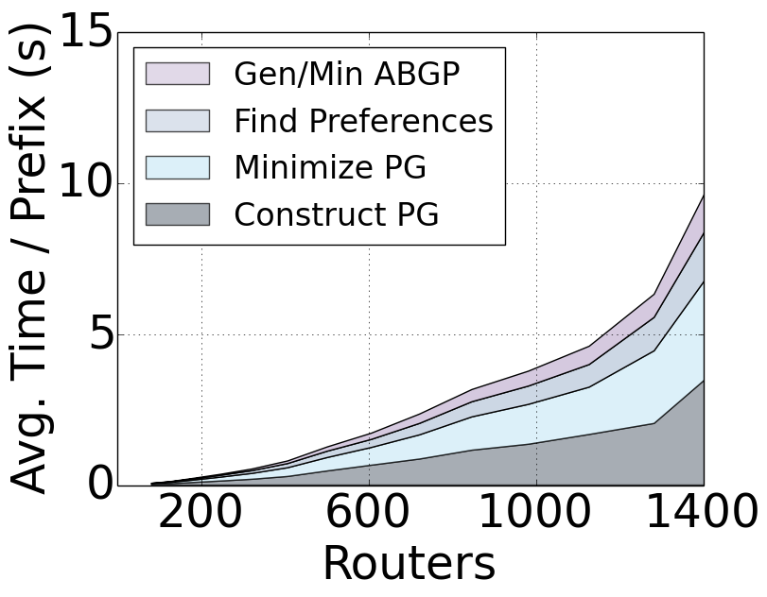
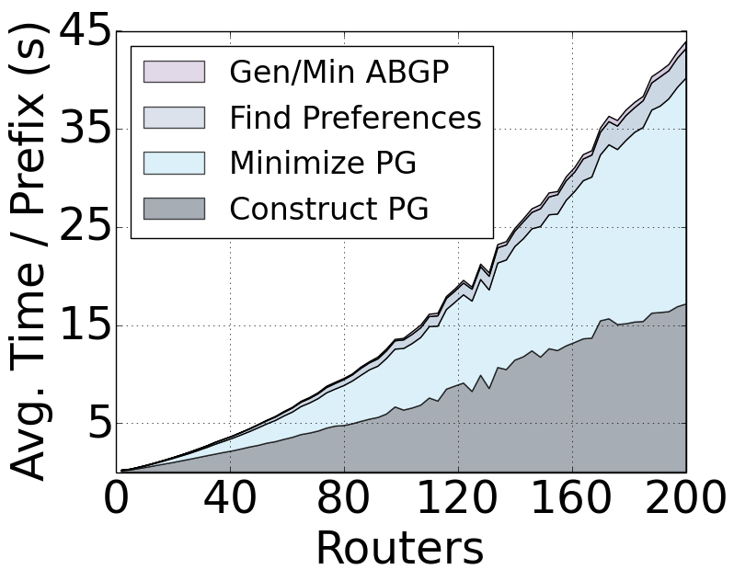
Compilation Time
Parallelize compilation by prefix
Use artificial topology to explore scalability
Data center (< 9 min)
Backbone (< 3 min)

Slide 96
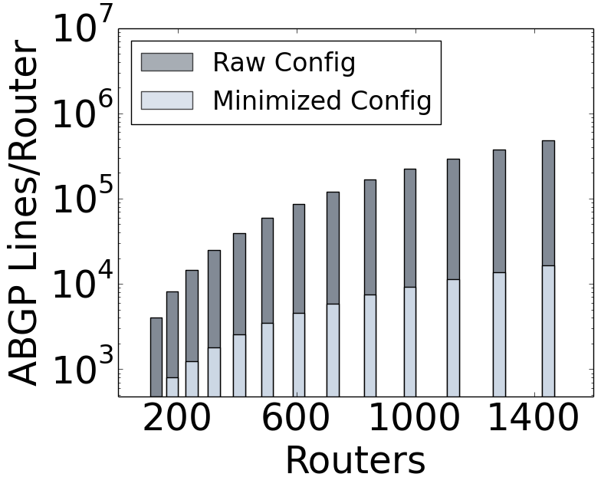
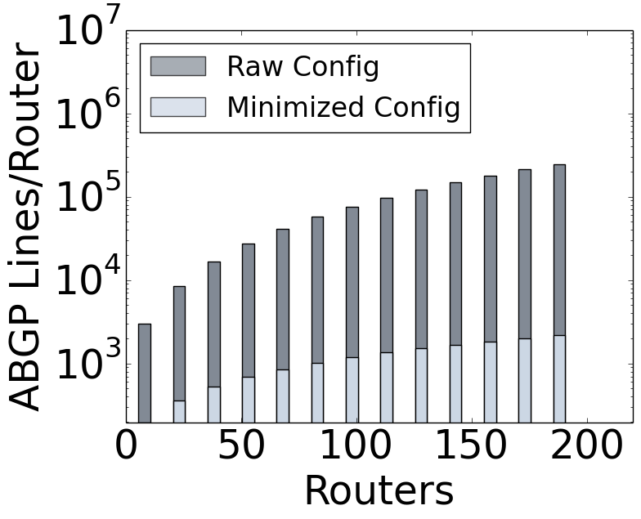
Configuration Size
Perform configuration minimization during generation
Avoid using community tags when choices are unambiguous
Fall-through elimination of route maps
Data center
Backbone

